Slide 1
Neural Networks in Computer Vision

Slide 2
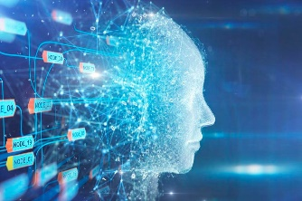

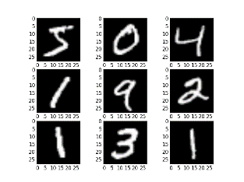
What is Deep Learning?
Artificial Intelligence
Any technique that enables computers to mimic human behavior
Machine Learning
Ability to learn without explicitly being programmed
Deep Learning
Extract patterns from data using neural networks

Slide 3
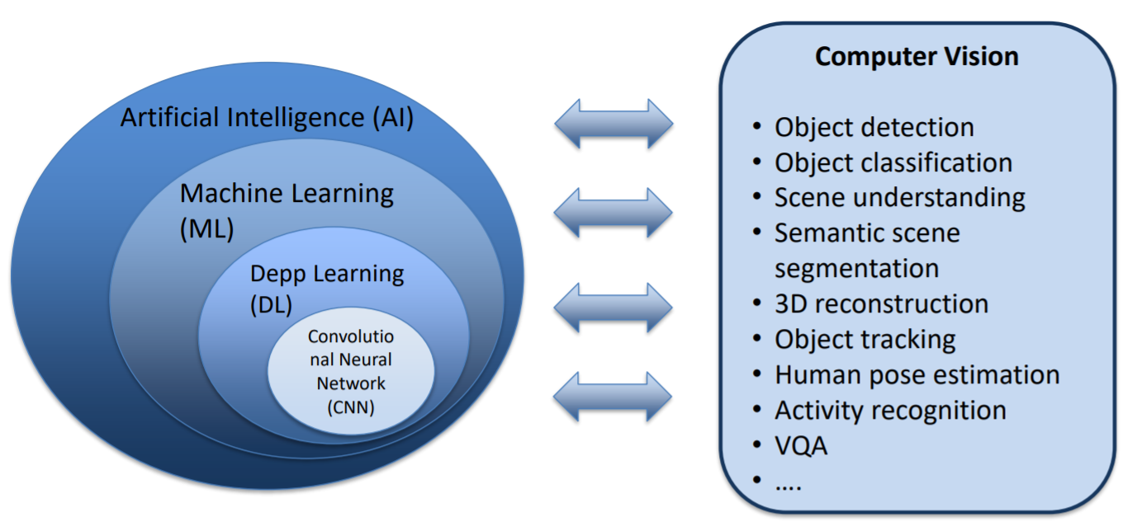
What is Deep Learning?

Slide 4
Why do we need Deep Learning?

Slide 5
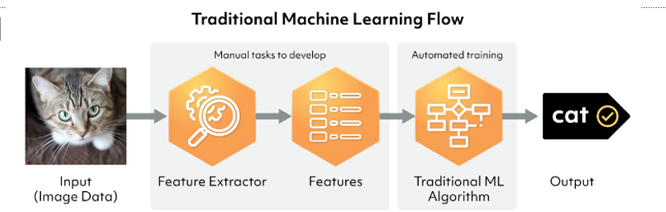
Why do we need Deep Learning?
https://www.dynam.ai/what-is-computer-vision-technology/

Slide 6
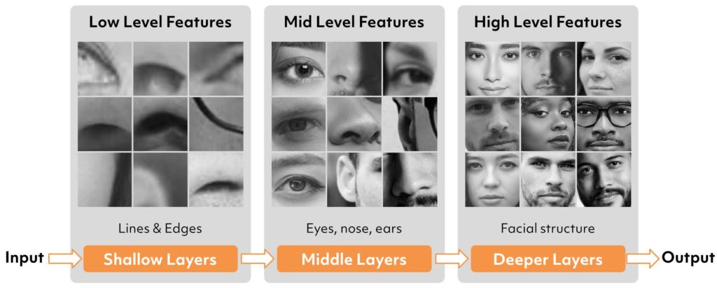
Why do we need Deep Learning?
Hand engineered features are time consuming, brittle, and not suitable in practice.
https://www.dynam.ai/what-is-computer-vision-technology/

Slide 7
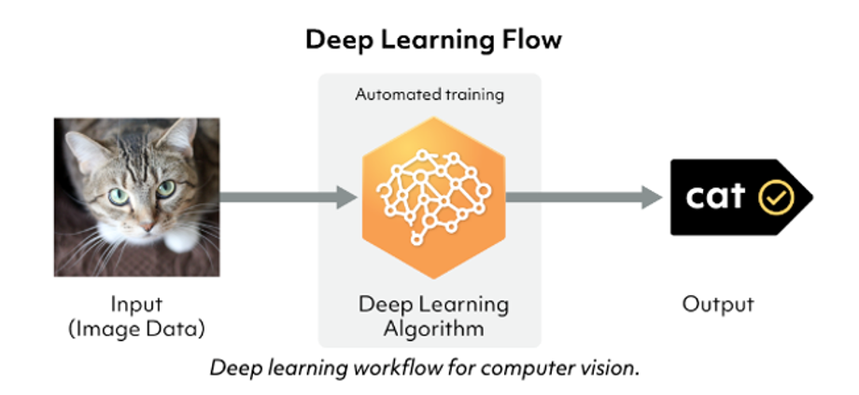
Why do we need Deep Learning?
https://www.dynam.ai/what-is-computer-vision-technology/

Slide 8

Why do we need Deep Learning?

Slide 9
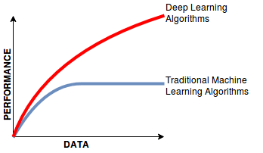
Why do we need Deep Learning?
A contemporary data science method to keep up with the growth in data, older learning algorithms no longer performing

Slide 10


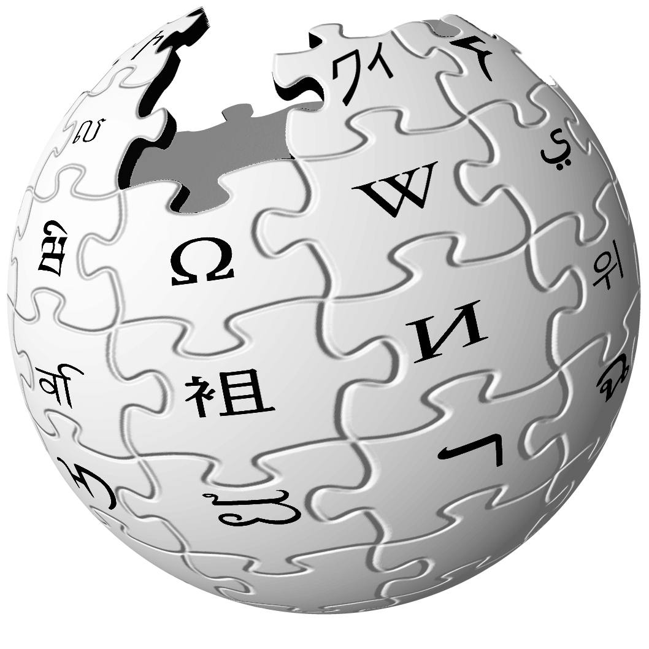



Why Now?
Neural networks are very old, so why is it important now.
Big Data
Larger dataset
Easier to store
Hardware
Graphical Processing Units (GPUs)
Support parallel processing
Software
Improved algorithms
New Frameworks and libraries

Slide 11
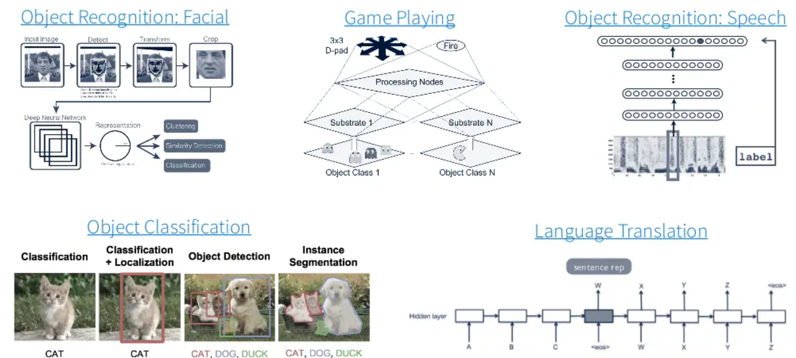
What it can do for you?

Slide 12
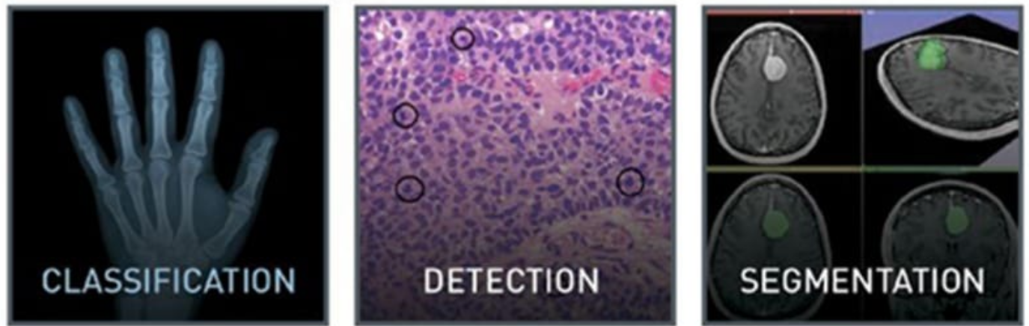
What it can do for you?
Healthcare

Slide 13
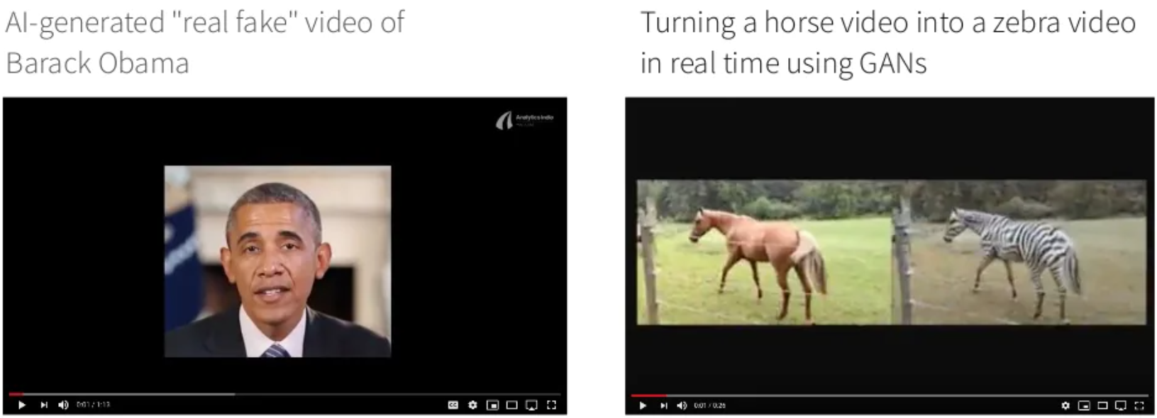
What it can do for you?
Generating images or videos

Slide 14
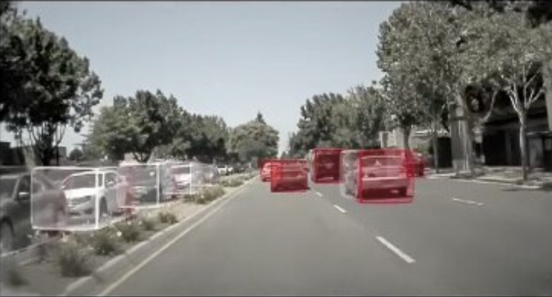
What it can do for you?
Self driving cars

Slide 15
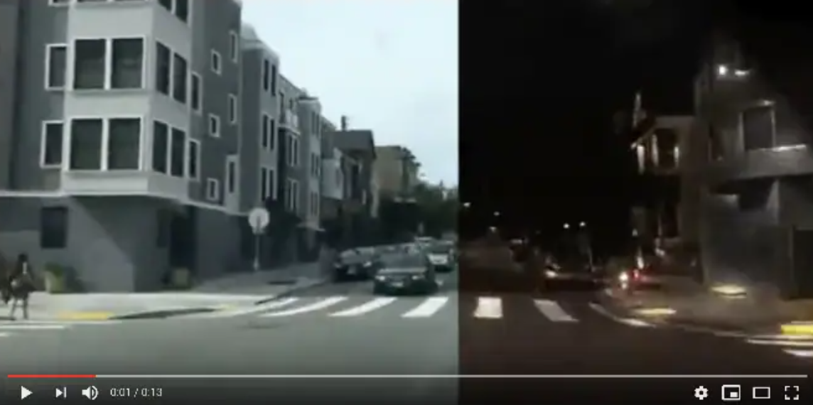
What it can do for you?
Turning the day into night

Slide 16
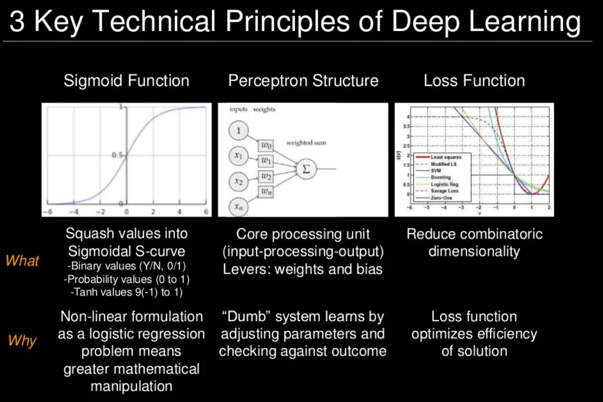

Slide 17
The Perceptron
The structural building block of deep learning

Slide 18
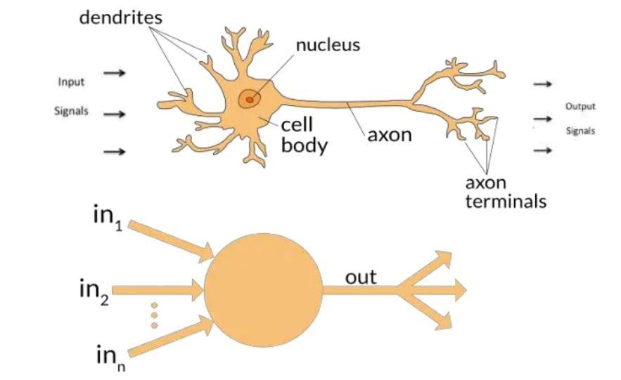
The Perceptron: Motivation
Create an artificial perceptron to solve problems the same same way a human brain would

Slide 19
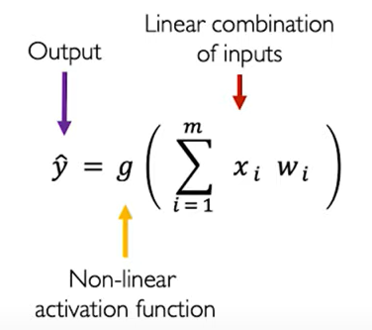

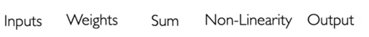
The Perceptron: Forward Propagation
X1
W1
X2
Σ
1
ŷ
W2
W3
Xm

Slide 20
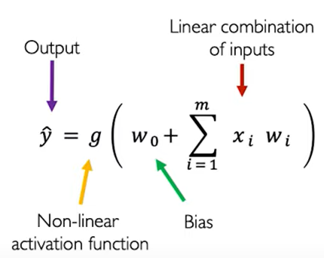
The Perceptron: Forward Propagation
1
Wo
X1
W1
Σ
1
ŷ
W2
X2
W3
X2

Slide 21
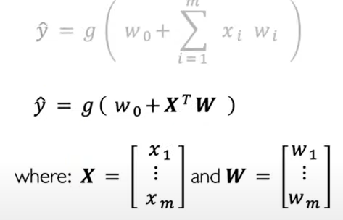
The Perceptron: Forward Propagation
1
Wo
X1
W1
Σ
1
ŷ
W2
X2
W3
X2

Slide 22
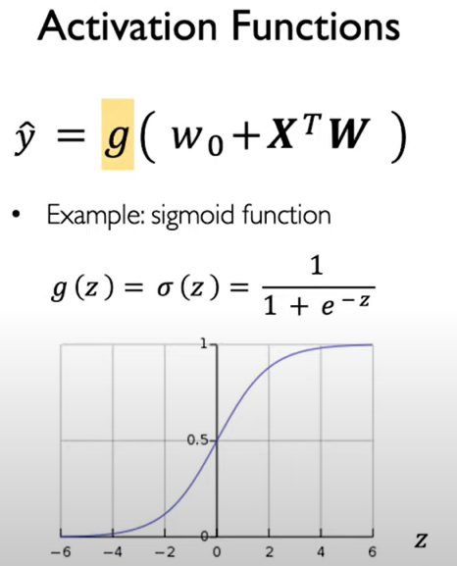
The Perceptron: Forward Propagation
1
Wo
X1
W1
Σ
1
ŷ
W2
X2
W3
X2

Slide 23
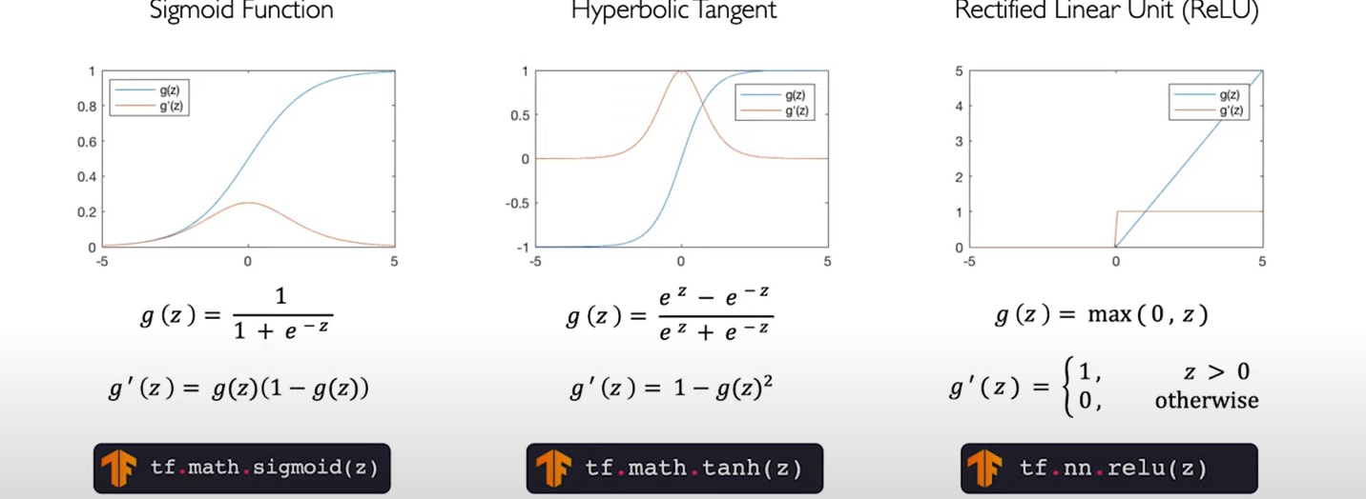
Common Activation Functions

Slide 24
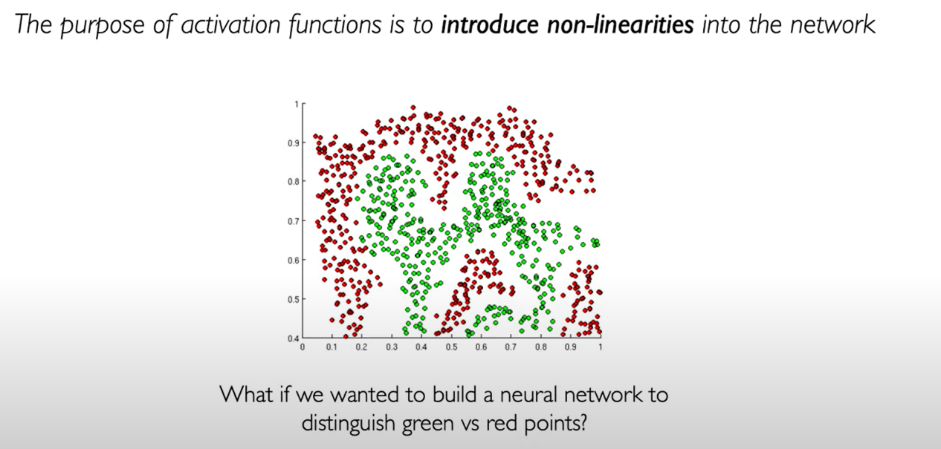
Why Activation Functions are Important?

Slide 25
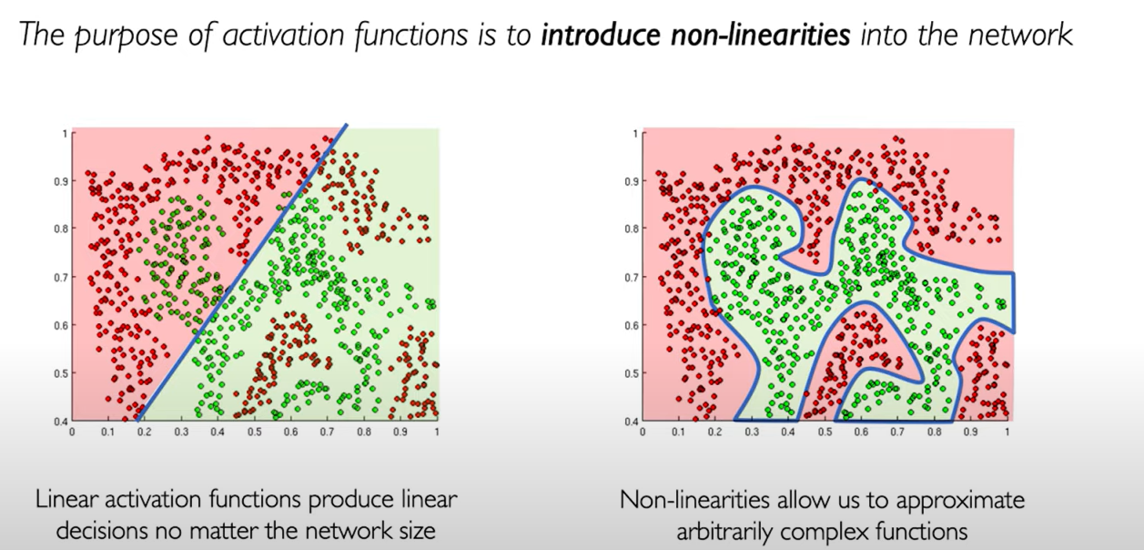
Why Activation Functions are Important?

Slide 26
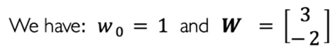
The Perceptron: Example
1
1
X1
3
Σ
1
ŷ
-2
X2

Slide 27
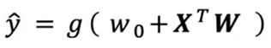
The Perceptron: Example
1
1
X1
3
Σ
1
ŷ
-2
X2

Slide 28
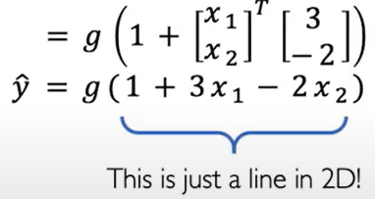
The Perceptron: Example
1
1
X1
3
Σ
1
ŷ
-2
X2

Slide 29
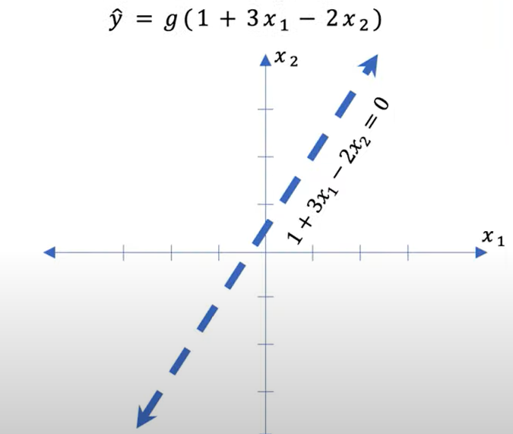
The Perceptron: Example
1
1
X1
3
Σ
1
ŷ
-2
X2

Slide 30
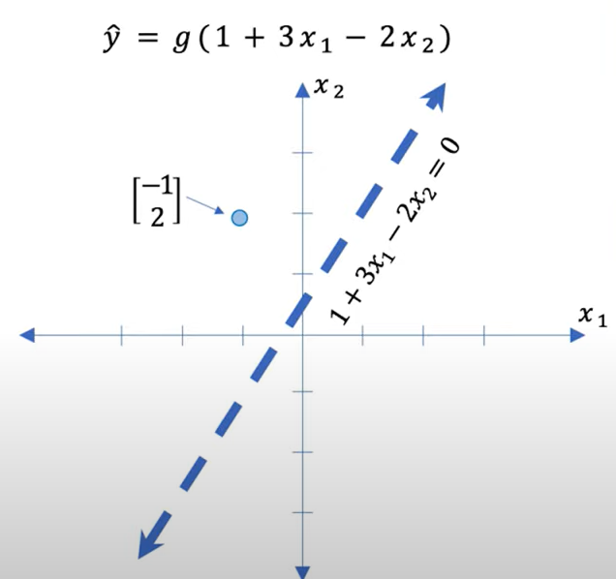
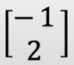
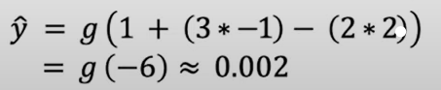
The Perceptron: Example
Assume we have X =
1
1
X1
3
Σ
1
ŷ
-2
X2

Slide 31
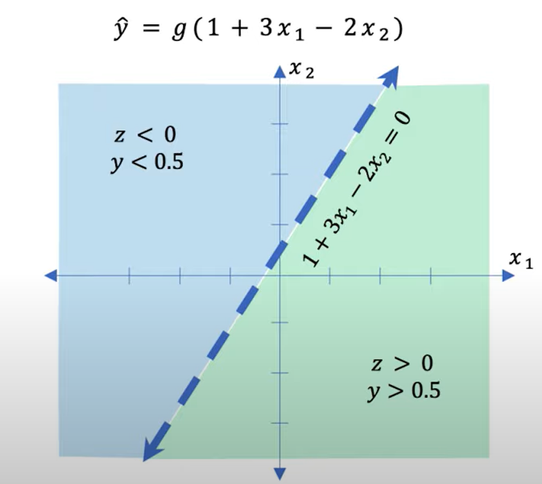
The Perceptron: Example
Assume we have X =
1
1
X1
3
Σ
1
ŷ
-2
X2

Slide 32
Building Neural Network with Perceptron

Slide 33
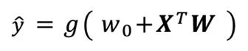
The Perceptron
1
Wo
X1
W1
Σ
1
ŷ
W2
X2
W3
X2

Slide 34
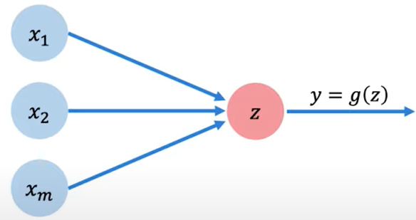
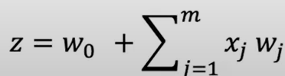
The Perceptron

Slide 35
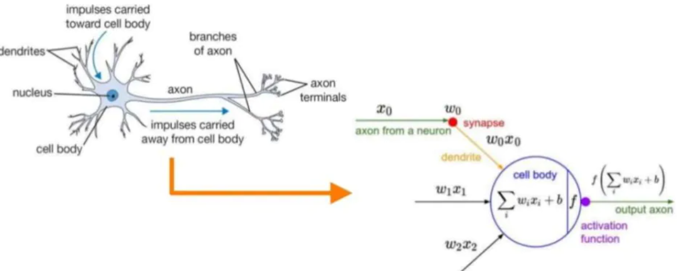
What is a Neural Network?
Structure: Input-Processing-Output
Mimic neuronal signal firing structure of human brain with computational processing unit

Slide 36
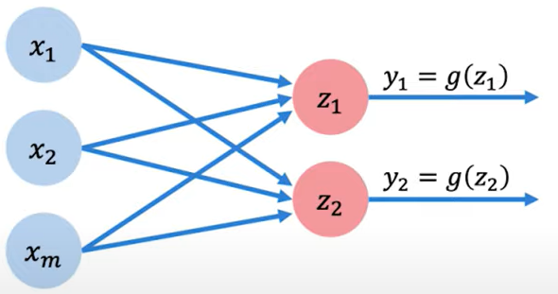
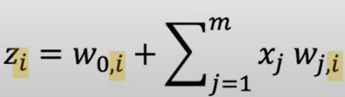
Multi Output Perceptron

Slide 37
Multi Output Perceptron
All inputs are directly connected to the output layers
Each neuron in the dense layer receives input from all neurons of its previous layer.
dense layer or fully connected layer

Slide 38

Dense Layer from scratch
class MyDenseLayer (tf.keras.layer.layer):
def _init_self(self, input_dim, output_dim):
super(MyDenseLayer, self)._init_()
#intialyze weights and bias
self.w=self.add_weight([input_dim,output_dim])
self.b=self.add_weight([1,output_dim])
def cell(self,input):
#forward propagate the input
z=tf.matmul(inputs,self.w)+self.b
#read through a non-linear activation
output=tf.math.sigmoid(z)
return output

Slide 39

Multi Output Perceptron
import tensorflow.keras
Layer.tf.keras.layers.Dense(units=2)

Slide 40
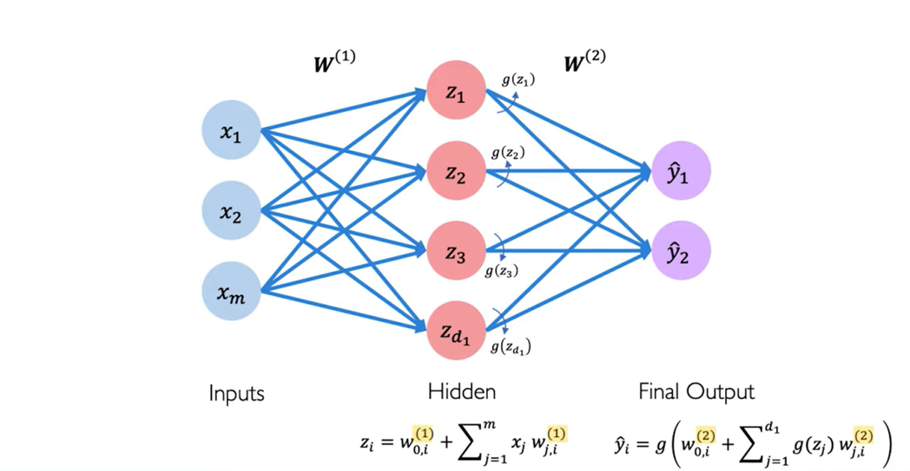
Single Layer Neural Network

Slide 41
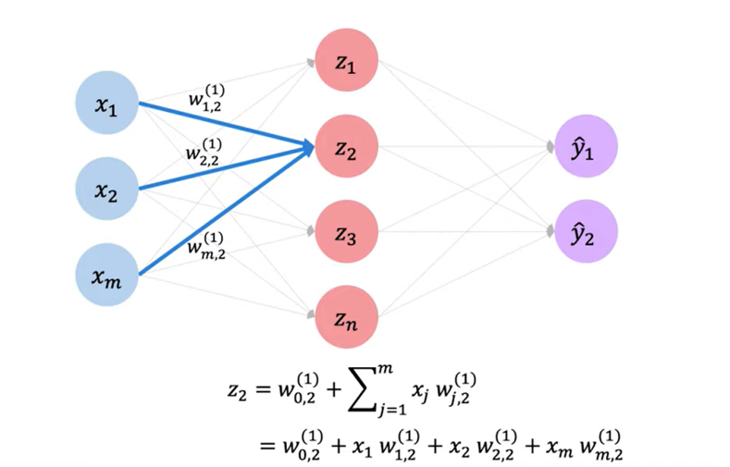
Single Layer Neural Network

Slide 42
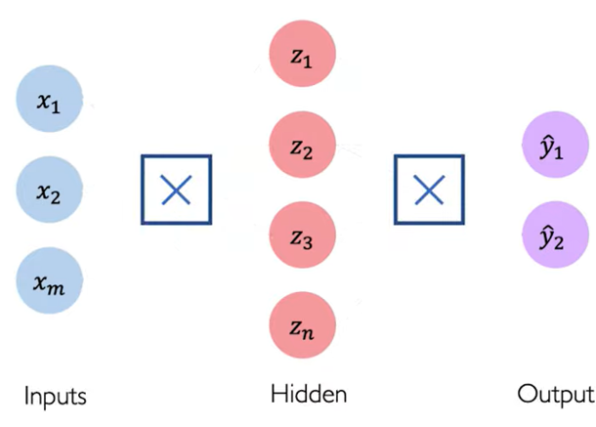
Multi Output Perceptron

Slide 43
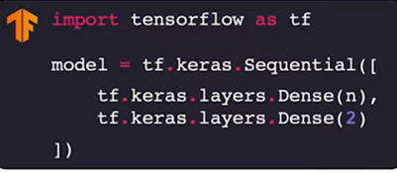
Multi Output Perceptron

Slide 44
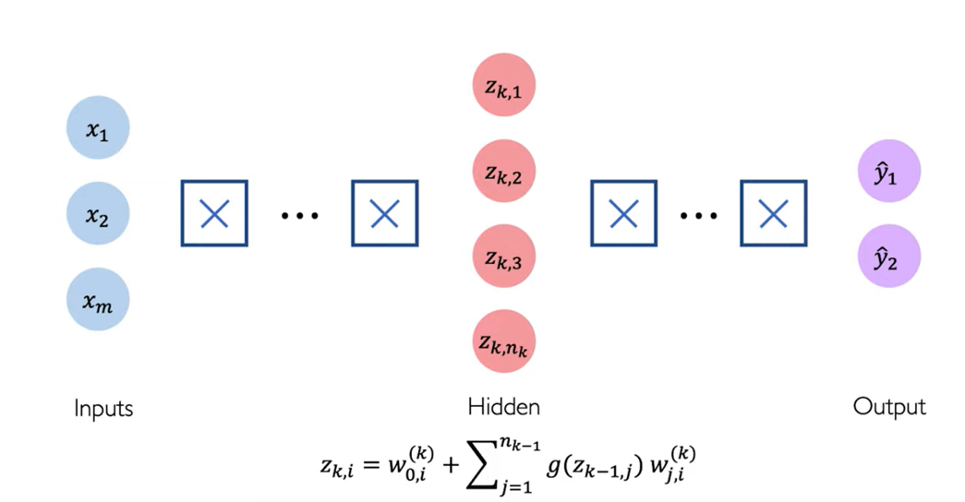
Deep Neural Network

Slide 45
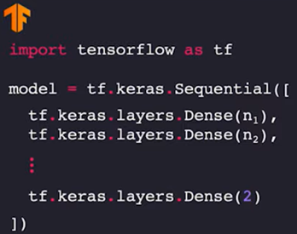
Deep Neural Network

Slide 46
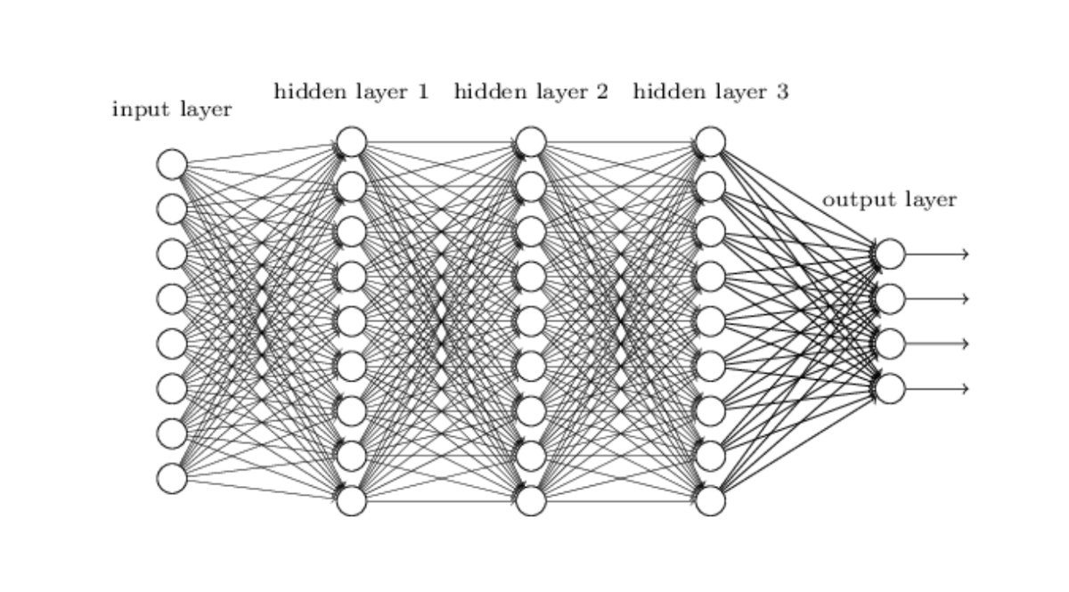
Deep Neural Network

Slide 47
Example of Neural network for OCR
Feedforward network
Trained using Back- propagation

Slide 48
Different Non-Linearly Separable Problems
Types of
Decision Regions
Exclusive-OR
Problem
Classes with
Meshed regions
Most General
Region Shapes
Structure
Single-Layer
Half Plane
Bounded By
Hyperplane
A
B
B
A
B
A
Two-Layer
Convex Open
Or
Closed Regions
A
B
B
A
B
A
Three-Layer
Arbitrary
(Complexity
Limited by No.
of Nodes)
A
B
B
A
B
A

Slide 49
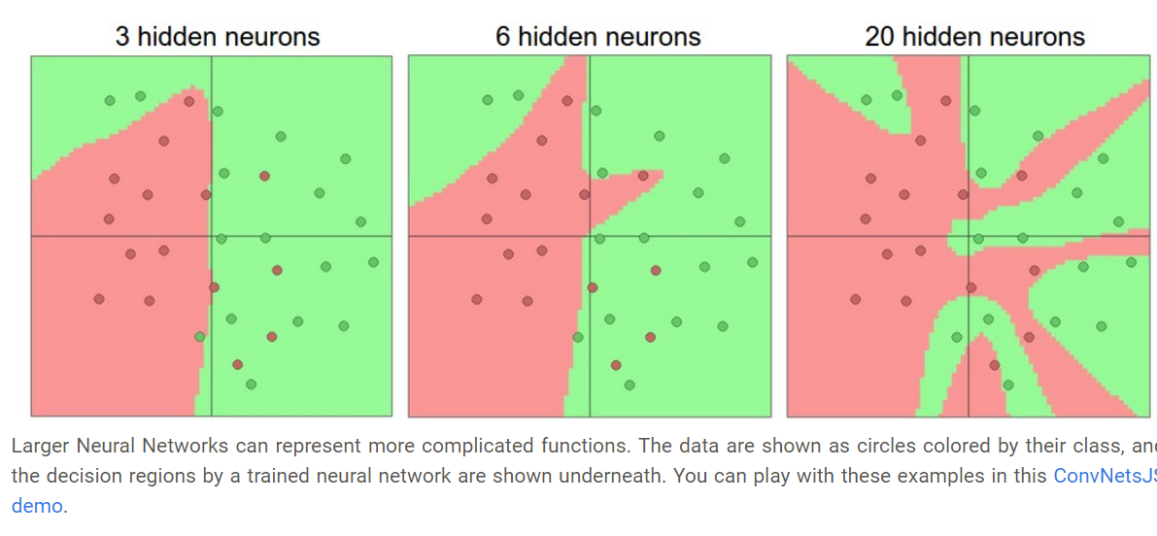
Different Non-Linearly Separable Problems

Slide 50
Applying Neural Network

Slide 51
Example: Will I get the job
Will I get the job
Two features model
X1= years of experience
X2= Number of correct answers during interview

Slide 52
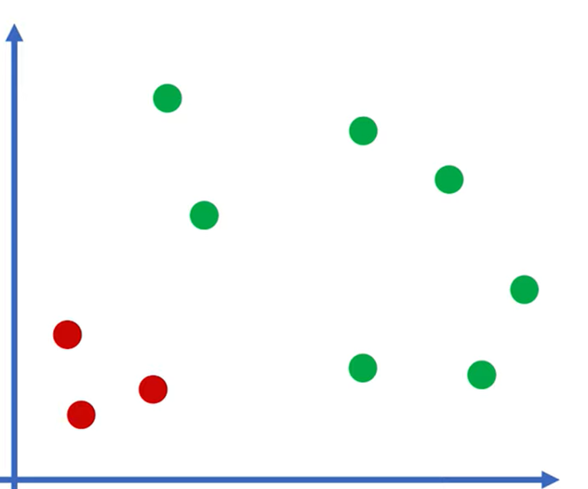

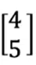
Example: Will I get the job
X2= Number of correct answers during interview
?
Got Job
Failed
X1= years of experience

Slide 53
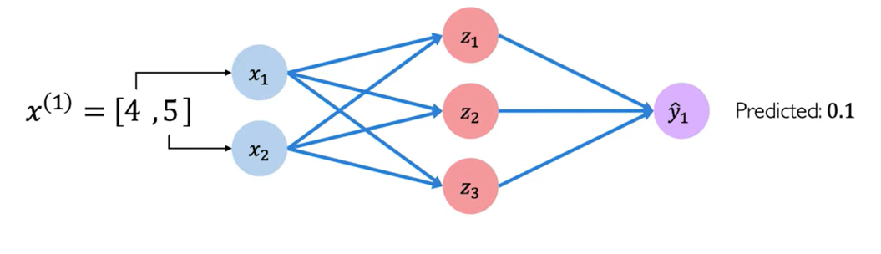
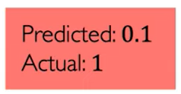
Example: Will I get the job

Slide 54
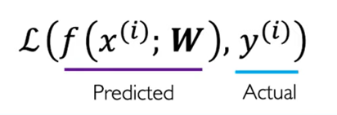
Quantifying Loss

Slide 55

Empirical Loss

Slide 56

Binary Cross Entropy Loss

Slide 57

Mean Squared Error Loss
Interview Score

Slide 58
Training Neural Network

Slide 59


Loss Optimization

Slide 60


Gradient Descent

Slide 61

Gradient Descent

Slide 62


Gradient Descent

Slide 63



Gradient Descent
Algorithm
W1
Wo

Slide 64

Gradient Descent
Algorithm
W1
Wo

Slide 65

Gradient Descent

Slide 66

Gradient Descent

Slide 67
Gradient Descent

Slide 68

Computing Gradients: Back Propagation

Slide 69

Computing Gradients: Back Propagation

Slide 70

Computing Gradients: Back Propagation

Slide 71

Computing Gradients: Back Propagation

Slide 72

Computing Gradients: Back Propagation

Slide 73
Computing Gradients: Back Propagation

Slide 74
Neural Network in Practice: Optimization

Slide 75

Training Neural Network is Difficult

Slide 76

Training Neural Network is Difficult
https://blog.paperspace.com/intro-to-optimization-in-deep-learning-gradient-descent/

Slide 77

Loss Functions Can be Difficult to Optimize

Slide 78

Loss Functions Can be Difficult to Optimize

Slide 79

Setting Learning Rate

Slide 80

Setting Learning Rate

Slide 81

Setting Learning Rate

Slide 82

Setting Learning Rate

Slide 83

Setting Learning Rate

Slide 84

Setting Learning Rate

Slide 85


How to deal with this

Slide 86

Adaptive Learning Rates

Slide 87

Gradient Descent Algorithms

Slide 88

Gradient Descent Algorithms

Slide 89

Can Replace Gradient Descent Algorithms

Slide 90
Neural Networks in Practice: Mini-Batches

Slide 91


Gradient Descent

Slide 92


Stochastic Gradient Descent

Slide 93


Stochastic Gradient Descent

Slide 94


Mini-Batches while Training

Slide 95
Neural Networks in Practice: Overfitting

Slide 96

Problem of Ovefitting

Slide 97


Regularization

Slide 98

Regularization 1: Dropout

Slide 99

Regularization 1: Dropout

Slide 100

Regularization 1: Dropout

Slide 101

Regularization 2: Early Stopping

Slide 102


Regularization 2: Early Stopping

Slide 103

Regularization 2: Early Stopping

Slide 104

Regularization 2: Early Stopping

Slide 105

Regularization 2: Early Stopping
Underfitting
Overfitting

Slide 106

Core Foundation Review

Slide 107
References
https://blog.paperspace.com/intro-to-optimization-in-deep-learning-gradient-descent/
https://www.dynam.ai/what-is-computer-vision-technology/
http://introtodeeplearning.com
a

Slide 108
Thank You!
Q&A

